Slide 1


Slide 2

Lecture 2. Accounting Concepts and Policies

Slide 3
Learning Outcomes:
Upon successful completion of the session, students will be able to…
1. Define and apply qualitative characteristics of financial information;
2. Apply accounting concepts;
3. Apply accounting policies.

Slide 4
Accounting concepts can be classified into 3 main categories:
BOUNDARY RULES
MEASUREMENT RULES
ETHICAL RULES

Slide 5

Boundary Rules
1.Separate Business Entity
The corporation is separate and distinct from its owners.

Slide 6
Boundary Rules
Example
Person named Mr. Brown who owns a house that has a market value of $300,000. He has a business of textiles named Texticom where he has invested $150,000 as on Jan 1st, 2019. During the year 2019, Mr. Brown withdraws $7,000 from the business for his personal use. The assets of the business include plant & machinery worth $4000, computer worth $5,000. Mr. Brown has also done shopping worth $500.
Comment and analyze the above scenario.

Slide 7

Boundary Rules
2.Going concern or Continuity. The valuation of the assets and liabilities of a corporation is based on the assumption that the company is going to continue in business for a reasonable period of time in the future.

Slide 8

Boundary Rules
3. Time period / Periodicity – financial statements should be prepared at the end of a defined period of time, and this period should be adopted as the regular accounting (reporting) period. Usually entities use twelve-month period to prepare their financial statements.

Slide 9

Boundary Rules
4. Transaction Approach / Quantitative – accountants only record events that can reasonably be determined in monetary terms.

Slide 10
Measurement Rules
Measurement rules – explain how accounting data should be recorded.
Money Measurement
Historic Cost
Realization
Matching
Dual Aspects
Materiality

Slide 11


Measurement Rules
Measurement based on the Monetary Unit – the monetary unit is used as the standard to record all transactions of the company. Otherwise, it would be difficult to compare the relative performance of the same company over time or the performance of two companies for the same time period.

Slide 12
Limitations of money measurement concept
Measurement Rules
Some people think that accounting financial statements tell you everything you want to know about a business.
Accounting does NOT show the following:
Whether the business has good or bad managers;
Whether there are serious problems with the workforce;
Whether a rival product is about to take away many of the best customers;
Whether the government is about to pass a law which will cost the business a lot of extra expense in future

Slide 13

Measurement Rules
2. Historic cost – this concept requires that assets be recorded at the value of their original or historic cost even though this may differ from current (present) market cost.

Slide 14
Measurement Rules
Example:
A plant and machinery is going to be purchased by ABC incorporation. Initial price was $5,000. ABC incorporation purchased the machinery for a discounted amount of $4,500. The transportation cost of the machinery was $20 for which $10 was paid by the dealer and remaining $10 by ABC incorporation. ABC incorporation also paid $15 as installation cost.
What will be the value of these plant and machinery in accounting books?

Slide 15
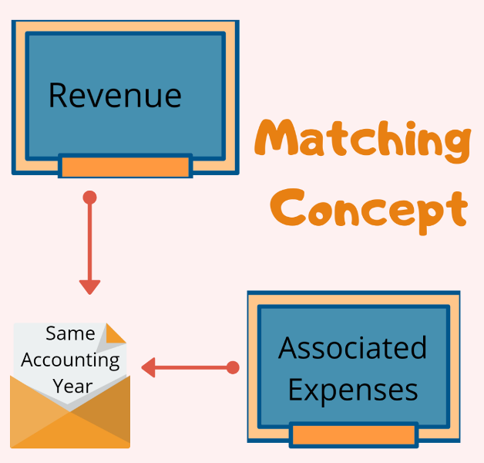
Measurement Rules
3. Matching – the revenue earned in one period should be matched only with relevant expenses incurred in generating the revenue during the same period to enable a fair calculation of the profit or loss for the period.

Slide 16

Matching
Measurement Rules
What is REVENUE?
What are EXPENSES?

Slide 17
Measurement Rules
Matching - Revenue recognition
IAS 18 provides guidance for recognizing revenue.
It deals with revenue arising from three types of transaction or event:
Sale of goods
Rendering of services
Interest, royalties and dividends from the assets of the enterprise
Example:
A firm sells goods for $20,000 for cash, the revenue for the firm is $20,000
A firm sells goods for $35,000 on credit, the revenue for the firm is $35,000
A bank gave an interest of $5,000 on deposits for 2019 to a firm. This is a revenue for the firm in 2019

Slide 18
Measurement Rules
Matching - Expense
outflows of cash or usage of assets, for the purpose of generating revenue in a particular period
Example:
A firm pays $25,000 for its employees’ salaries. This is an outflow of cash and therefore an expense to the firm.
A firm pays $25.00 for postage, an expense to the firm.
A firm purchased a machine for $50,000 on 1 Jan 2019. The expected life of the machine is 10 years. The usage of the machined for the year ending 31 Dec 2019 is $5,000 ($50,000/10 years –the life of machine). The usage of machine is an expense. Such usage is called ‘depreciation’.

Slide 19
Measurement Rules
Matching
Then, from the examples (assuming that every transactions
occurred in the same period, we would have the following:
Expenses ($): Revenue ($)
Salaries 25,000 Sales:
Postage 25 cash 20,000
Depreciation 5,000 credit 35,000
Interest rec’vd 5000
Total 30,025 Total 60,000
The difference :
Revenue > Expenses = Profit/Income
Revenue < Expenses = Loss

Slide 20
Measurement Rules
4. Realization rule – determines when a transaction is regarded as “realized” and can be entered in the accounts. In financial accounting, the two main basis of realization are:
Cash basis or cash flow accounting – revenue or expenditure is realized and recorded based on the flow of cash. Revenues are not recorded until received in cash; and expenses are assigned to the period in which the cash payments are made.
Example: Laila sold goods for $3,000 for cash in 2019 and the goods have also been delivered in the same year

Slide 21
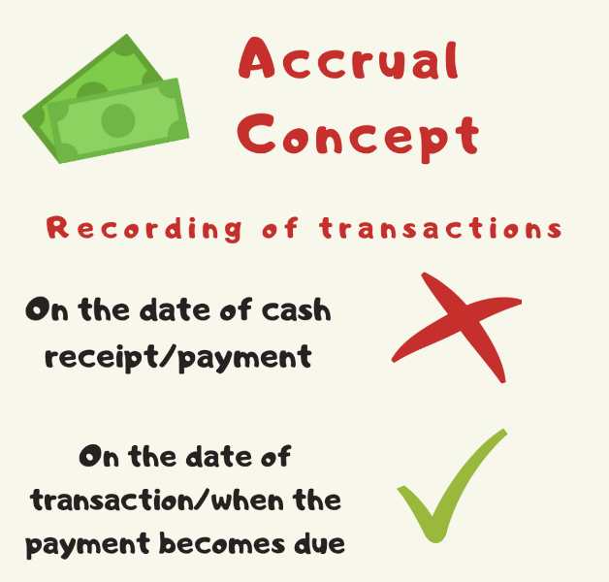
Measurement Rules
Accrual basis – revenue or expenditure is realized at the point of sale or purchase which may not be similar to the receipt or disbursement of cash. The accrual basis of accounting recognizes revenue in the period in which they are earned and in the same period deducts the expenses incurred in generating those revenues.

Slide 22
Measurement Rules
Example:
On 31 March (end of accounting period), a businessman sold a shirt for $150, the cost is $130. $100 cash received on 31/3 and $50 received on 15 April.
Which of the following answer is correct and why? On 31 March,
Revenue is $150 OR
Revenue is $100 because we received on $100 on 31/3

Slide 23
Measurement Rules
5. Duality – for each and every accounting transaction two entries are effected
Examples:
Buy machine and pay $15000 in cash
Entries affected:
cash & machine
2. Pay rent to landlord ???
Sold goods on credit to Nancy??
Purchase furniture on credit from Peter???

Slide 24
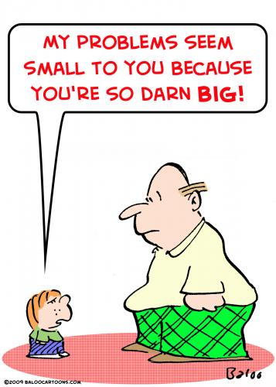
Measurement Rules
6. Materiality/immateriality
– not necessary to follow the accounting rules strictly (can ignore accounting rules) if the item under consideration is immaterial/insignificant and applying the accounting rules strictly will involve a disproportionate amount of additional recording.

Slide 25

Ethical Rules
Ethical rules – to limit the room for individual maneuver and subjectivity.
Prudence
Consistency
Objectivity
Relevance

Slide 26
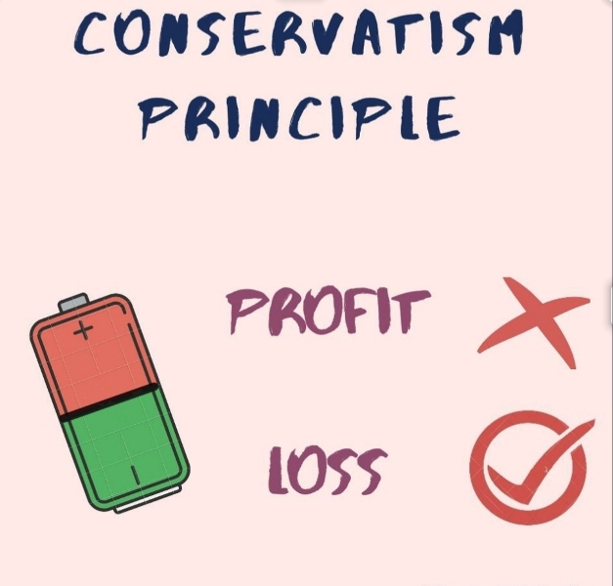
Ethical Rules
1.Prudence or Conservatism
– the measurement with the least favorable effect on net income and financial position should be selected, so that the net income and financial position presented is the most conservative.
“If in doubt, overstate losses and understate profit”

Slide 27

Ethical Rules
2.Consistency – once specific accounting policies have been adopted, they should be followed in all subsequent accounting periods.

Slide 28

Ethical Rules
3.Objectivity – personal / individual bias should be minimized when interpreting the accounting rules and adapting them to suit particular circumstances.
Values are based upon a factual occurrence
No own interpretation on the facts

Slide 29

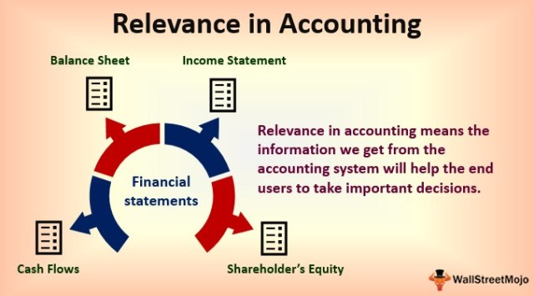
Ethical Rules
4.Relevance – only relevant information related to the objectives of the specific user groups should be provided. Discretion is needed to group information into categories and sub-categories as too much details can be confusing to information users.

Slide 30

Additional concepts
Full disclosure – accounting reports are required to disclose all important information, either as part of the main reports or in the form of footnotes.

Slide 31
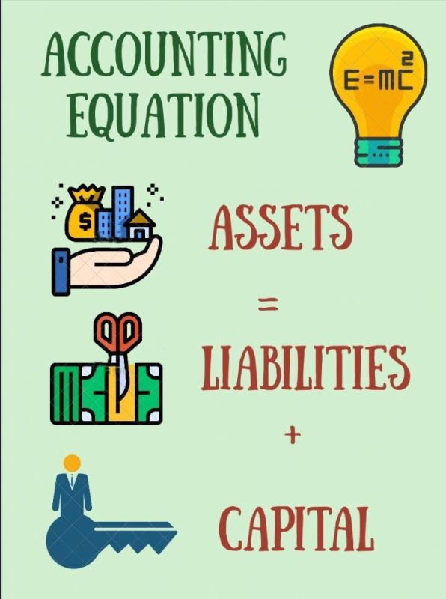
Additional concepts
Accounting equation – states that
Assets = Liabilities + Owners’ Equity,
in other words,
what you Have = Owe + Own.
This equation is the basis used in the preparation of the balance sheet.

Slide 32
Qualitative characteristics of financial statements
Understandability:
The financial statements are published to address the shareholders of the company. So it is important that these statements must be prepared in such a way that is easy to understand and interpret for the shareholders. The information provided in these statements must be clear and legible.
Relevance:
The information provided in the financial statements must be relevant to the needs of its users. So the information provided in these financial statements must be relevant to the ‘information needs’ of all these stakeholders, which could affect their economic decisions.

Slide 33
Qualitative characteristics of financial statements
Comparability: financial statements must be prepared in such a way that they are comparable with prior year financial statements. This enables the users of the financial statements to identify and plot trends and patterns in the data provided, which makes their decision making easier.
Reliability:
The information provided in the financial statements must be reliable and true. The information extracted to prepare these financial statements must be from reliable and trustworthy sources. This means that the information provided must not have any significant errors or material misstatements.

Slide 34
Qualitative characteristics of financial statements
Timeliness:
All the information in the financial statements must be provided within a relevant span of time. The disclosures must not be excessively late or delayed so that while making their economic decisions the users of these statements posses all the relevant and up-to-date knowledge. Although this characteristic may take more resources but still it is a vital characteristic as delayed information makes any corrective reactions irrelevant.

Slide 35
Homework
Find out limitations of historic cost concept
What is substance over form concept?
What is the assumption of stability of currency concept?

Slide 36
Lecture Roundup:
1. In preparing financial statements, accountants follow certain fundamental assumptions.
2.The IASB's Conceptual Framework is the basis on which IFRSs are formulated.
3. The main underlying assumption for financial statements is going concern.
4.The Conceptual Framework states that qualitative characteristics are the attributes that make the information provided in financial statements useful to users.
5.The two fundamental qualitative characteristics are relevance and faithful representation.
6.Enhancing qualitative characteristics are comparability, verifiability, timeliness and understandability.
7.There are other accounting concepts which are useful in the preparation of financial statements.

Slide 37
References
Dyson, J.R (2004) Accounting for Non-Accounting Students, chapter 2
ACCA (2017) Approved Interactive Text. Foundations in Accountancy FFA 2017/2018. BPP Media Ltd

